Slide 1

Evolution of Maternal Health in Bangladesh
and philosophy of professor Dr. Mukhlechur Rahman
Dr. Md Emdadul Haqus
Associate professor of Gynae&Obs
Addin Sakina Women’s Medical Collage, Jashore

Slide 2

The philosophy of Prof. Dr. Mukhlechur Rahman
1st Aug. 1920 – 31st Dec. 1995
“I am the representative of the mothers of Bangladesh. I want safe motherhood like safe fatherhood.”
“During the marriage of your daughter, you should mention in Kabinnama that your daughter should delivered her baby in hospital”

Slide 3
Particulars of prof. Mukhlechur Rahman
Professor Dr. Mukhlechur Rahman was born in 1st August in 1920 in Bhola. His father,s name Md.Momtaz Uddin Ahammed. His ancestral home was Chormollikpur under Lohagara upazilla in Narail district.
He passed Matriculate in 1939 from Barisal Zilla School and ISc. from Barisal BM College in 1941. He admitted in Calcutta Medical Collage in 1942. and passed M.B in 1946. He was the 1st RS (Gynae) of Dhaka Medical Collage Hospital in 1946.
He got DGO from London in 1965. He worked in Mymenshingh and Sylhet Medical Collage. In 1978, he joined as a professor of Obs & Gynae at DMC.
He retired in 1980. He died on 31st December in 1995 at BIRDEM due to liver cancer.
He was involved in MRTSP program, 1st private medical collage initiative at Bajitpur under Kishoregonj district.

Slide 4
History and Evolution of Maternal Health service in Bangladesh
1946 – Establishment of DMC.
1953 – Starting of FP program by Non-govt. system.
1960 – Rural Health Complex Development by local Govt.
1963 – Starting of Family planning service in Govt. program.
1973 – Integration of district health council with Govt. program.
1976 – National family planning policy.
1979 – MR policy adopted and started EPI and training of TBA.
1980 – MCH breast family planning program.
1985 – Intensification of EPI.
1994 – EOC program started.
2001 – Maternal Health strategy 2001.
2003 – Community based SBA program.
2006 – Maternal Health DSF program.
2000-2015 – MDG program.
2015-2030 – SDG program.

Slide 5
Maternal Health Situation in Bangladesh and Greater Jashore ( in 2021)
Indicator | Bangladesh | Greater Jashore
Total Pregnancy | 35.09 lak | 1.4 lak
Total delivery | 29.24 lak | 1.15 lak
Maternal death(172/lak LB) | 4,971 | 200
Maternal morbidity | 1,49,124 | 6,000
Perinatal death(20/1000 DL) | 58,480 | 2,300
Neonatal death(19.1/1000LB) | 55,836 | 2,196
Disability ( 10%) | 2.92 lak | 11,500
Low birth weight (14.5%) | 4.39 lak | 17,250
Hospital delivery(38%) | 11.11 lak | 43,700

Slide 6
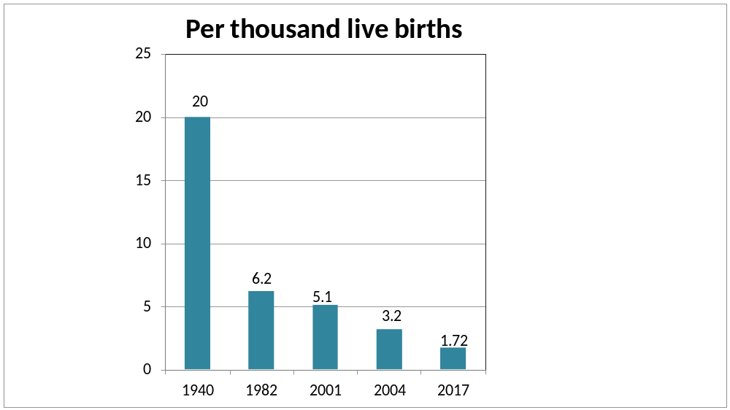
MMR in Bangladesh
From 1940-2017

Slide 7
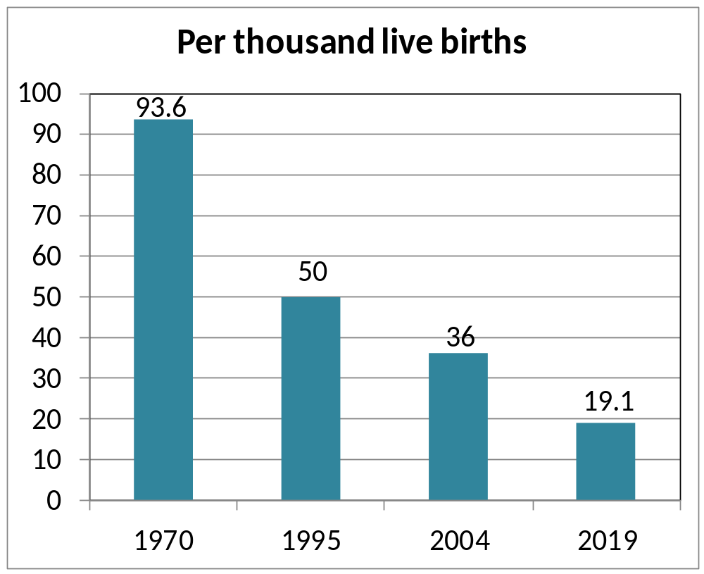
Neonatal Mortality rate in Bangladesh
From 1970-2019

Slide 8
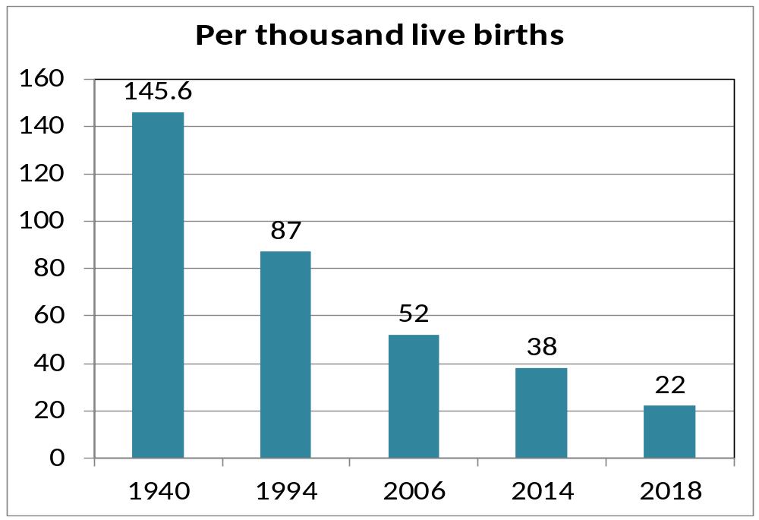
Infant Mortality Rate in Bangladesh
From 1940-2018

Slide 9
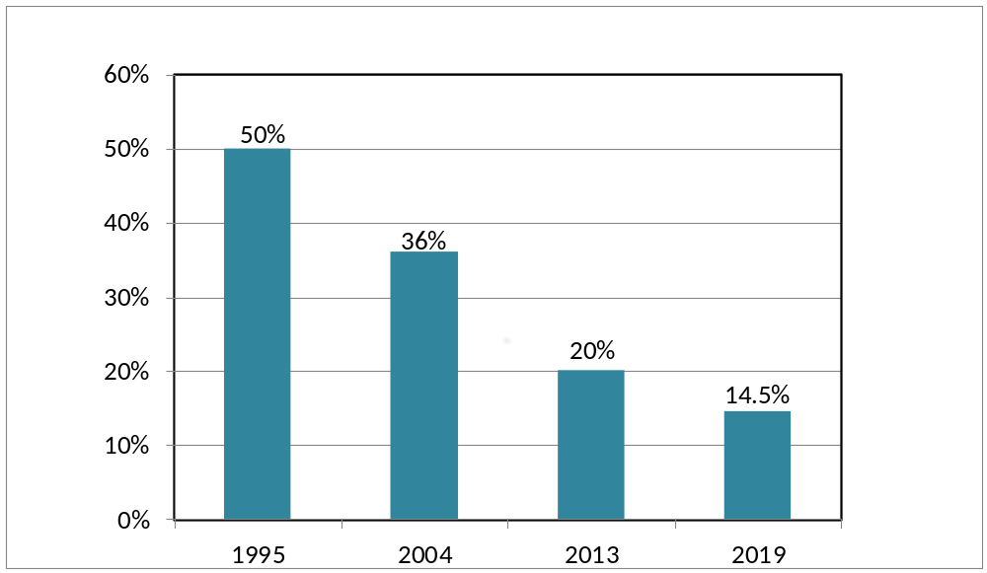
Low birth weight situation in Bangladesh
From 1995-2019

Slide 10
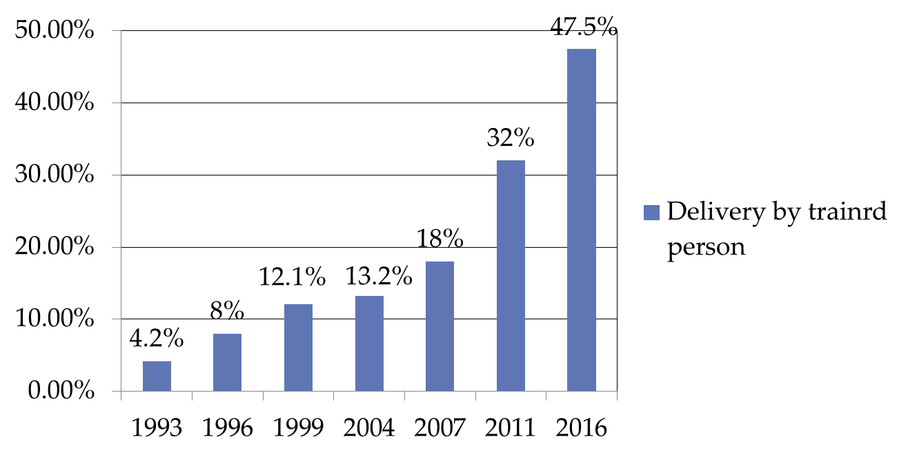
Delivery by trained person in Bangladesh
From 1993-2016

Slide 11
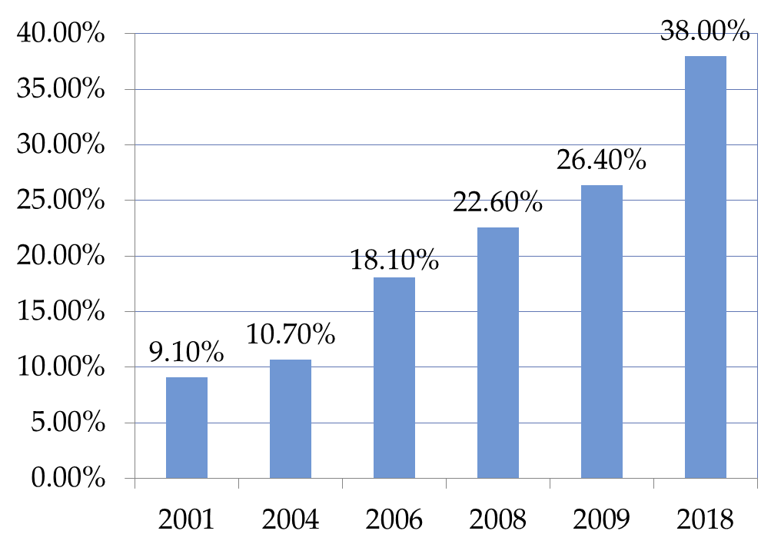
Trends in hospital delivery rate in Bangladesh
From 2001-2009

Slide 12
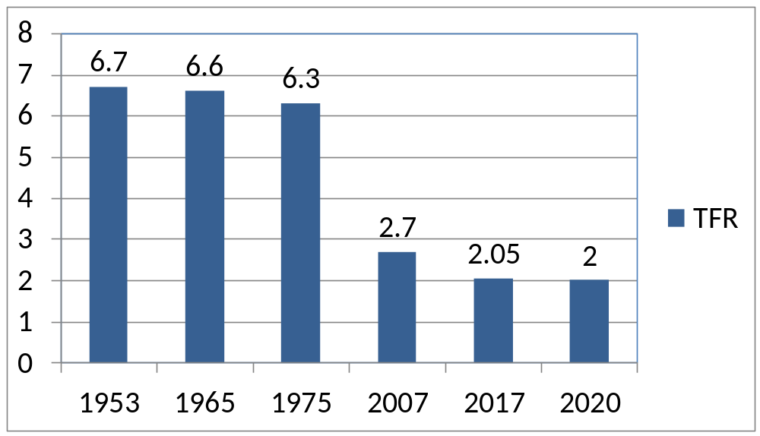
TFR in Bangladesh from 1950-2020
.
Family planning reduces:
    66% unwanted pregnancy.
    30% MMR.
    20% NMR.
    40% High risk pregnancy.

Slide 13
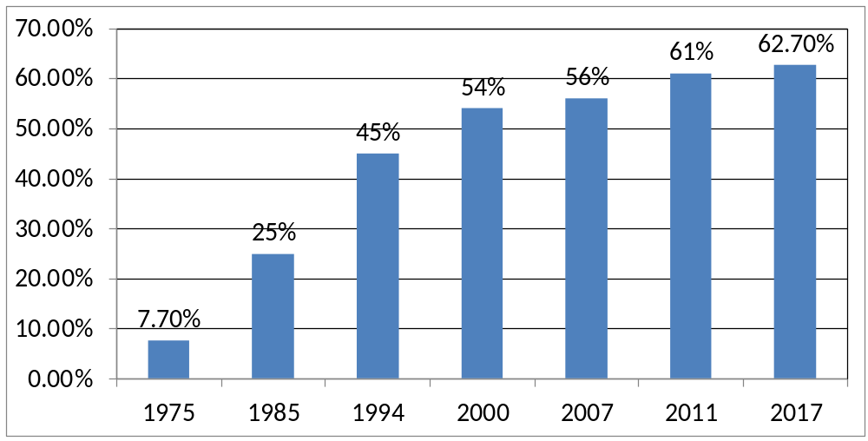
Contraceptive prevalence rate in Bangladesh
From 1975-2020
BDHS-2018

Slide 14
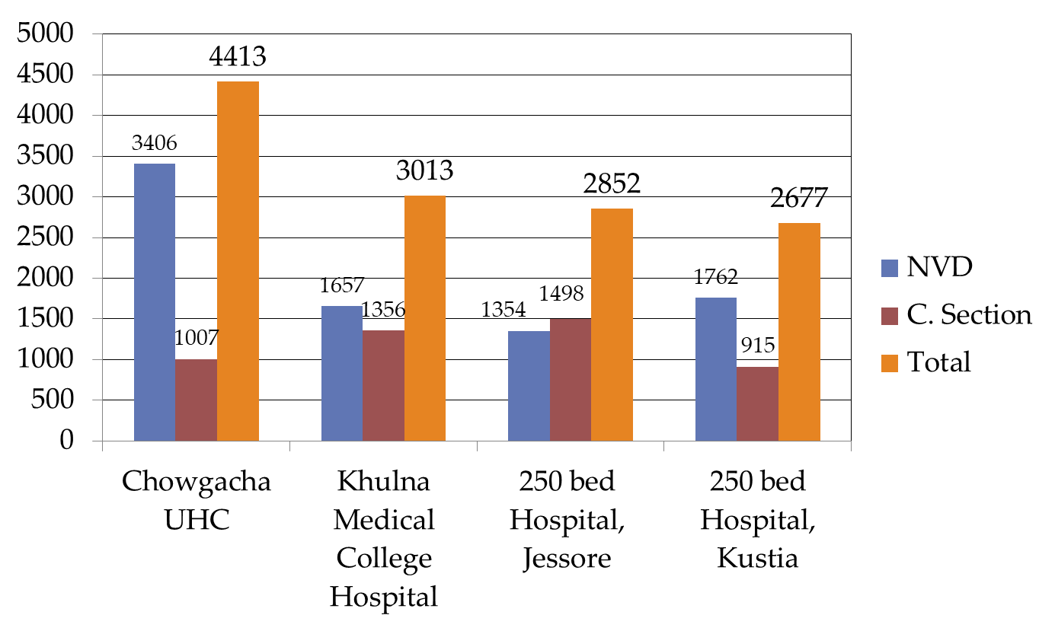
Comparative Data of Delivery of best performing EOC center of Khulna Division in 2011

Slide 15
Maternity service of Chowgacha UHC in 2011
  EOC Beds increased from 11 to 41(11+30)
  Hospital delivery rate in Chowgacha UHC was 02% in 1997 and increase to 98.4%(4413) in 2011.
  Among Chowgacha mothers hospital delivery rate was 69%in Chowgacha UHC. and among them C –Section rate was 12.8 % in 2011.

Slide 16
Way Forward
Every mother should deliver their baby in Gov. hospital.
Hospital bed should be increased to 1 bed per hundred delivery like Chowgacha UHC.

Slide 17
Summary of maternal health development in Bangladesh.
MMR reduced from 20 /1000 LB 1940 to 1.72/1000LB in 2017.
NMR reduced from 93.6 /1000LB in 1970 to 19.1/1000LB in 2019.
LBW reduced from 50% in 1995 to 14.5% in 2019.
TFR decreased from 6.3 1975 to 2 in 2020.
CPR increased from 7.7% in 1975 to 62.7% in 2017.
Hospital delivery increased from 4% in 1994 to 49% in 2018.
Chowgacha UHC create a example in hospital delivery rate >90 % in 2011.

Slide 18

Thank you

Slide 19


Slide 20


